Slide 1
Dark Web (Finance)
iQ4 Virtual Vault (Cyber Attack)
Notes:
GD mrn This is team VV and this the team lead AP we will be presenting as the cyber attack team.
There was a record-breaking number of data breaches in the US in 2021. 1,862 instances were reported last year according to the Identity Theft Resource Center’s 2021 Data Breach Report. The tsunami of data breaches can partially be attributed to the prevalence of the dark web, the festering internet underworld where several activities like drug dealing and human trafficking run rampant. The most prevalent still being several businesses and enterprises being cyberattacked. Financial firms are 300 times more likely than other institutions to experience them, according to the Boston Consulting Group. In a report published in January 2020, the Federal Reserve Bank of New York says the risk of spillover effects from cyberattacks is high because the banking system is interconnected. The report suggests a cyberattack on any of the five most active U.S. banks could affect 38% of the network.

Slide 2
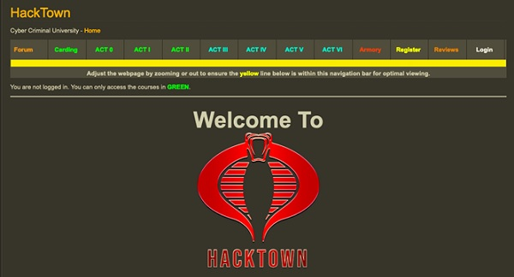
Marketplaces Identified
Dark0de Reborn
Hydra
ToRRez
Dark Fox
Notes:
The deep and dark web has a wide range of marketplaces that are essentially online stores that offer various illicit services and goods, such as firearms, stolen credit card data, drugs, counterfeit documents, and so on. There are particular darknet market features have to be considered before placing an order.
Dark0de Reborn is a premium marketplace in the dark web underground that includes a massive set of performances consisting of expert system, human communication support systems, sensational style as well as outright encryption. They use solid anti-phishing procedures and high-end security. The user interface is rather enticing and also notes a substantial variety of items from medications to electronic items as well as tutorials.
Hydra is one of the most effective darknet markets as well as is most acceptable amongst the Russian-speaking communities. According to a media outlet, the Hydra market is accountable for 64.7 billion rubles that accounts to $1 billion in sales by means of its 5,000 supplier shops between the years 2016 as well as 2019. The site has a couple of rules despite the sale of different illegal items and services. These policies are among the reasons sustaining its longevity and success.
ToRRez allows you to send funds when you are making an order. Presently, the market supports four major cryptocurrencies, viz., Monero, Bitcoin, Zcash as well as Litecoin. ToRReZ market openly markets electronic goods such as bank card as well as software together with physical products like medications.
DarkFox is one of the biggest deep web underground markets that offers all kinds of items. It usually markets drugs, but there is also a great deal of various other products available also such as personal ID scans, credit card information, gems and gold, fake things, carded items, software application and also many more. The marketplace sustains typical escrow and multisig.

Slide 3
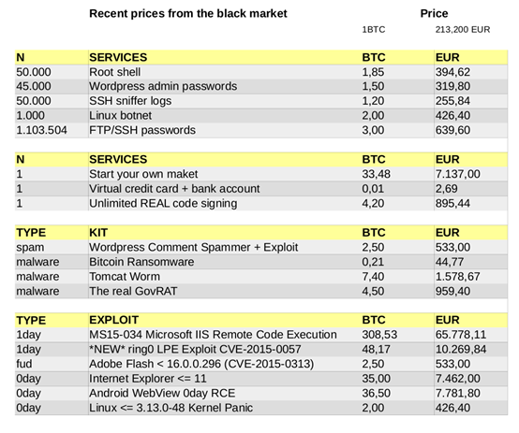
Potential Opportunities for Hacking Resources
Hacker marketplaces like Darkweb-sites.org and hire-a-hacker.onion.
HackTown – A college for criminal hackers.
Phishing Pages
Trojans and other cheap hacking tools
Cybercrime consultation
Notes:
Our recent investigation into the dark web market shows that strong malware, phishing pages, password-cracking software for famous brands, and an inconceivable cluster of other hacking devices are being sold on the internet (the dark web to be precise) for only a couple of dollars each. These highly encrypted sites (Dream, Wall Street Market, Empire) active on the dark web, which can only be accessed using the Tor browser, permit hackers to secretly sell hacking software, alongside a wide range of other stash, including illegal medications, leaked confidential information, and weapons.
With phishing as one of the most successful cyberattack vectors, it's not surprising that ambitious black hat hackers are selling phishing pages for many famous brands, including, Facebook, Amazon, Netflix, and PayPal.
Probably the most remarkable things we found available to purchase on the dark web were remote access trojans (RAT). This horrendous strain of malware permits hackers to take remote admin access to the victim’s PC. Not only would they be able to log all keystrokes and access private files like photos, videos and other official documents (which can be used for identity theft), it’s also shockingly normal to involve these RATs in spying on the victim’s webcam.
The dark web offers a successful career in cybercrime. Beginner to expert level resources are available for anybody needing to figure out how to perform crimes like online fraud, identity theft, know your customer (KYC) fraud, and loan fraud, with all the required tools sold as a bundle.

Slide 4
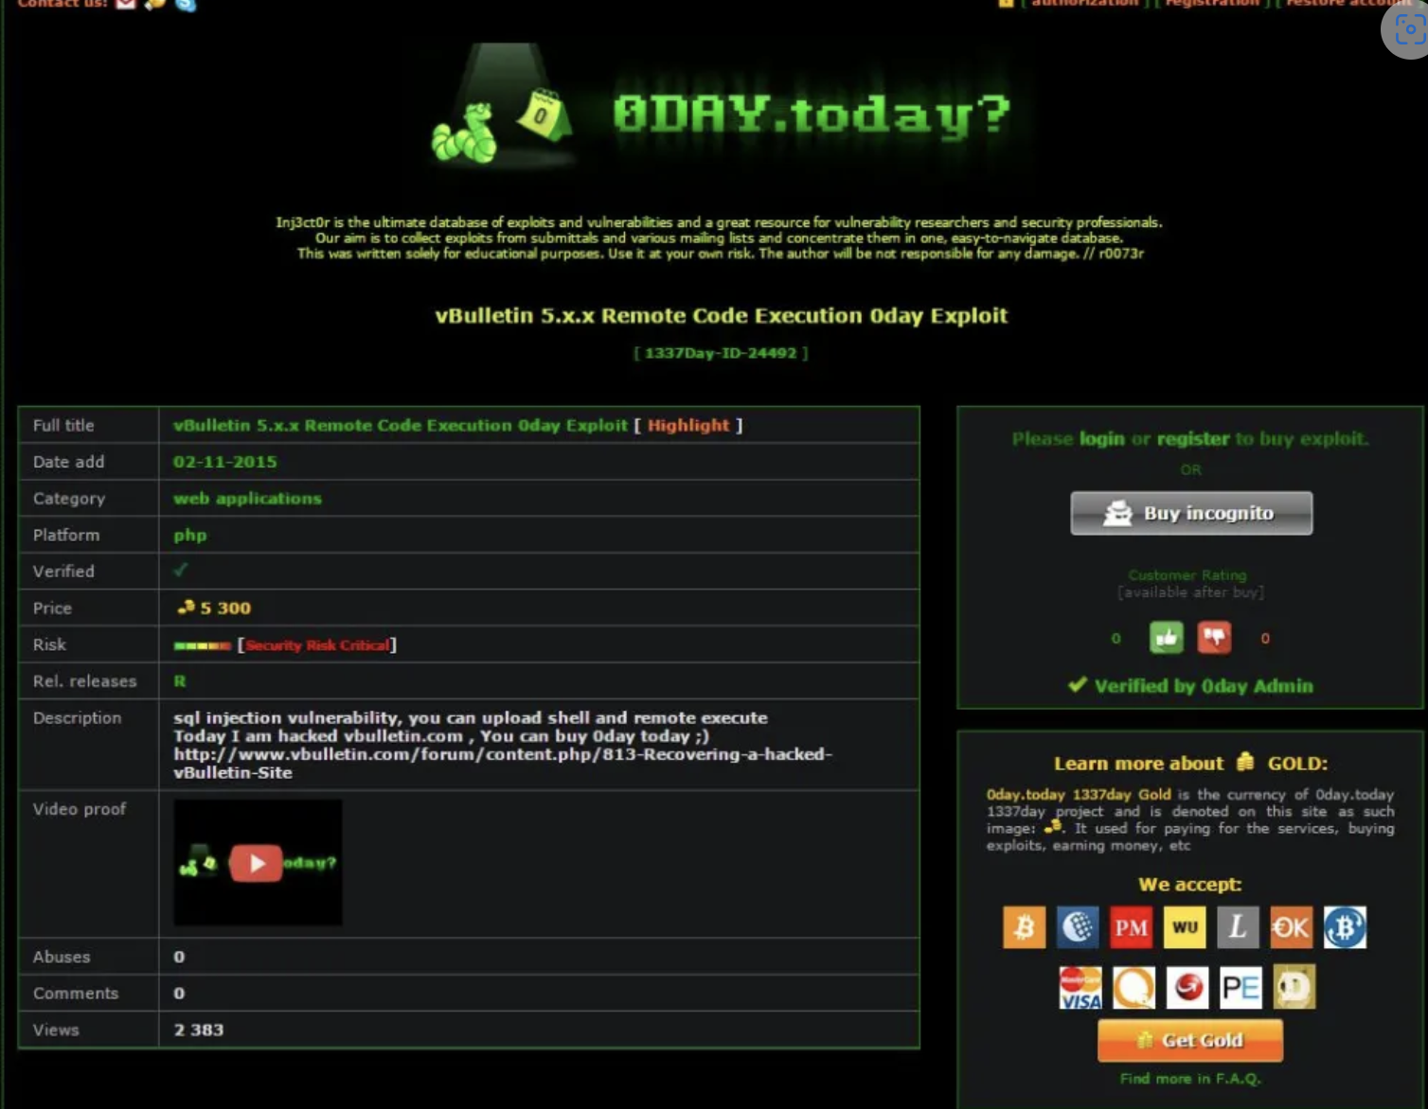
Exploiting Zero Day Vulnerabilities
1318% increase in cyber risk in the finance and banking sector.
Most prominent: Ransomware, Business Email Compromise (BEC), CryptoJacking, Zero Day Exploits.
Notes:
0-day vulnerability attacks have emerged as one of the major cybersecurity concerns in the last few years. It is known to target individuals, large enterprises, government agencies, and for that matter, any organization irrespective of its size or nature of the industry. According to data released by the Google Project Zero security team, they detected 20 zero-day vulnerability attacks in 2019 and 11 zero-days in the first half of 2020 in the wild. Once hackers have successfully identified a zero-day vulnerability, they try to leverage it to carry out attacks on a system, which is known as a zero-day exploit.
With a year-over-year increase of 1,318%, cyber risk in the banking sector has never been higher. In 2021, ransomware comprises the majority of cyber attacks on the banking industry. According to a report published by the US Treasury’s Financial Crimes Enforcement Network (FinCen), the 635 suspicious activity reports (SARs) filed in the first half of 2021 represent a 30% increase over the entirety of 2020.
While Accellion is a provider and developer of accounting software, a zero-day exploit in their Accellion File Transfer Appliance software gave hackers access to the databases of numerous banks and financial institutions. This cyber attack on the banking industry technically occurred at the end of 2020, but much of the fallout wasn’t seen until after the New Year.
Automatic Funds Transfer Services (AFTS) is a payment processor that was targeted by a group known as Cuba Ransomware in February 2021. The group accessed various financial and tax documents, individual account details, and other professional correspondence. This particular attack resulted in a widespread, successful ransomware campaign that targeted multiple state agencies in the US in addition to the financial sector.

Slide 5
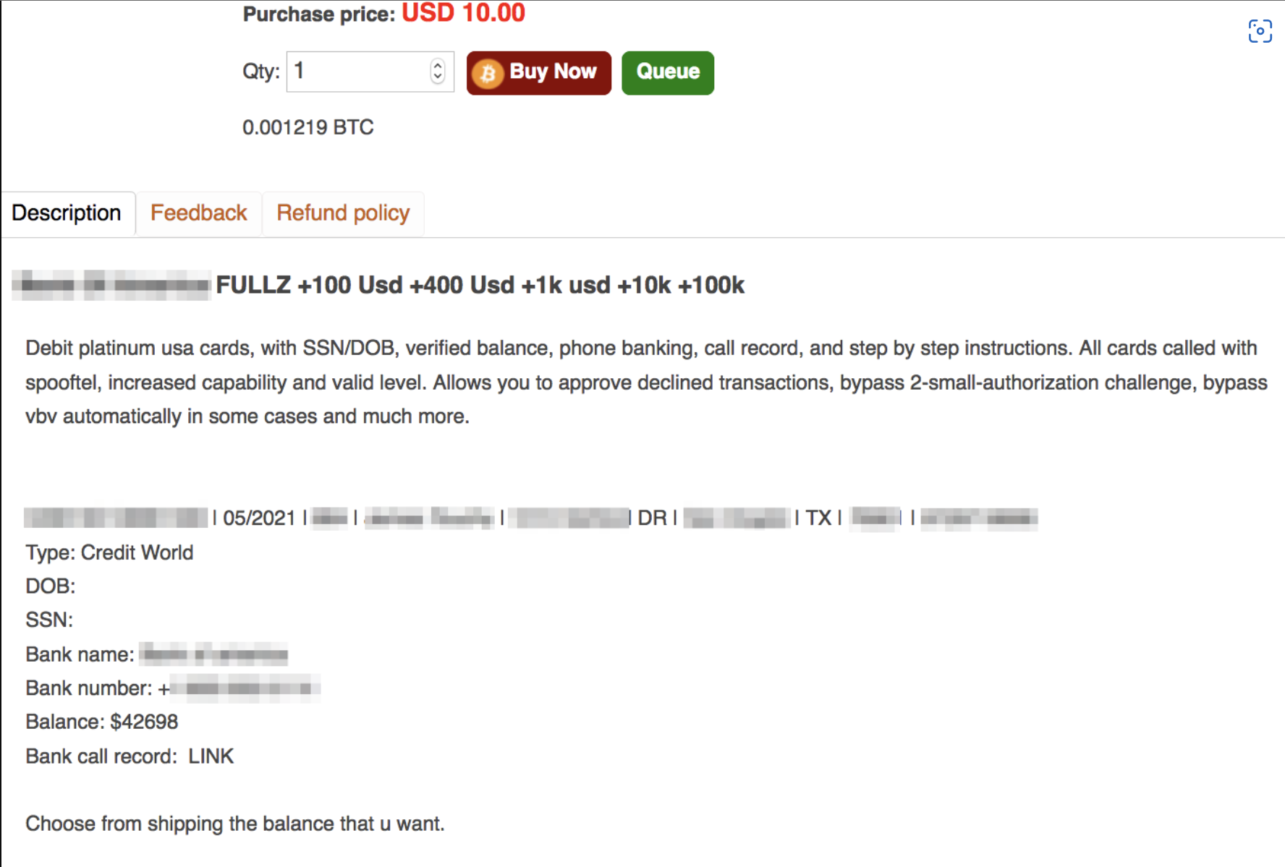
Potential Opportunities to Raise Funds
Exploiting Breached Data
Scampages
Bank Drops
Counterfeit Documents
Cloud Service Attacks
Other vulnerabilities and human error
Notes:
Financial fraud has existed as long as financial institutions. The online world is rapidly changing how age-old financial crimes, from Ponzi schemes to identity theft, are approached—but it is also creating entirely new types of financial fraud.
Breached financial data has a huge presence on the dark web, often in the form of “fullz” for sale on dark web marketplaces. “Fullz,” a complete set of financial PII, can include an individual’s full name, address, SSN, DOB, bank name/number, account numbers and balances, and credit card information. Breached data can also be found on paste sites, such as Pastebin (open web) or DeepPaste (dark web), which are used for publicly sharing blocks of plain text. These leaks can appear innocuous (e.g. public dumps of bank employee emails) because they can’t be monetized as easily as fullz.
One can purchase and sell scampages and templates on the dark web specifically designed to impersonate most major financial institutions. Scampage designs can be quite convincing, especially if targets do not evaluate their emails for suspicious links and content.
Bank drops are illegal bank accounts that enable money laundering. Drops are created using stolen financial information, typically from individuals or businesses with sound credit scores who are unlikely to be flagged. Fraudsters commonly use drops to hold stolen funds or order cards to commit ATM fraud. Dark web marketplaces offer a variety of fraudulent documents, including bank statements, cheques, fake debit or credit cards, and counterfeit currencies. Some of these are created by the vendor, while some of them are PSD templates that individuals can purchase and customize in Photoshop.
Cloud services offer financial institutions efficient, scalable, cost-effective data storage solutions. They also make internal data more prone to attack, and their vulnerabilities are rapidly increasing. In July 2019, an Amazon Web Services breach compromised 106 million Capital One credit card holder accounts—one of the largest financial breaches to-date.

Slide 6
Potential Risks
Organisations complying with the security standards (PCI-DSS)
Network Security like Firewalls and Anti-Virus
Use of Artificial Intelligence
Notes:
All businesses that process online credit card transactions should comply with the Payment Card Industry-Data Security Standard (PCI-DSS). PCI-DSS includes a set of twelve requirements to secure credit card data and other personal information related to online transactions. The requirements generally fall into several categories: Network security – e.g., properly using firewalls and anti-virus programs : Data security – e.g., encrypting transmission of consumer data and limiting internal access (both digital and physical) to consumer data on a need to know basis : Policies and procedures – e.g., instituting cybersecurity policies and providing continuous monitoring and frequent security testing.
Already, we’re seeing major banks put AI technology into practice that approaches fraud detection from a forward-thinking perspective rather than waiting until after fraud occurs to act. Recent data found that 63% of financial institutions believe that AI can prevent fraud, while 80% agree that AI plays a critical role in reducing fraudulent payments and attempts to commit fraud.

